Slide 1
PYNQ RADIO
WES 237A: Final Project
Steven Daniels
Jimmy Nguyen (A09563161)
3/14/2020

Slide 2
OBJECTIVE
Create an embedded application that uses an antenna to capture raw I/Q data packets from within the FM Radio band over the air, process the raw data, send the data from the PYNQZ2 board to a client PC, and play back the data.

Slide 3
Real World Application
Digital radio that a user could listen to anywhere they have an internet connection.
Live stream radio station.
Capture LTE signals

Slide 4
Hardware
Client PC
PYNQZ Z2
Dipole Antenna
RTL-SDR
Realtek RTL2832U chipset

Slide 5
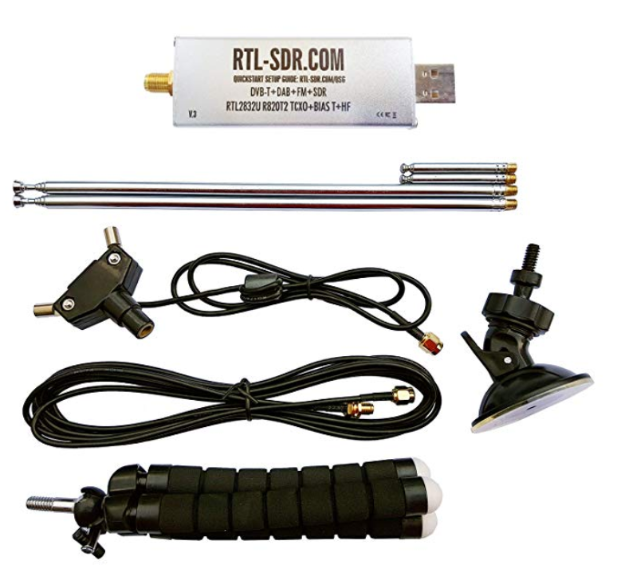
Dipole Antenna RTL-SDR

Slide 6
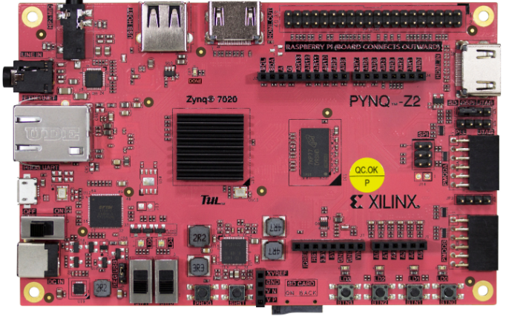
PYNQZ Z2

Slide 7
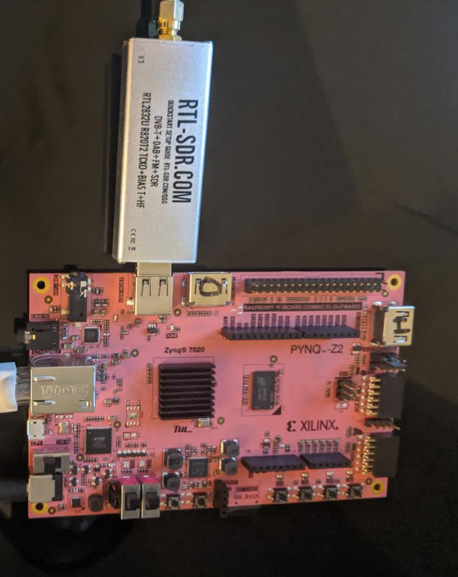
Setup

Slide 8
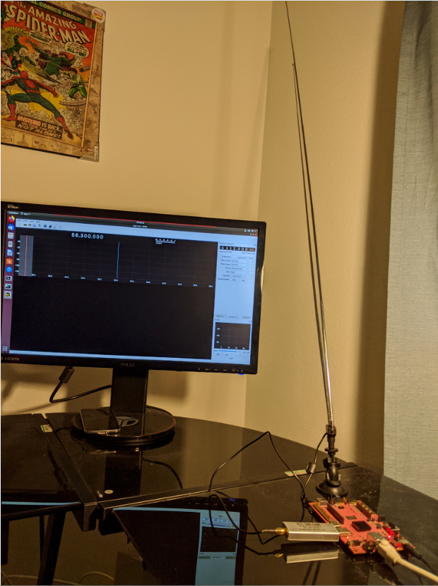
Setup

Slide 9
Software
GNU Radio
https://www.gnuradio.org/
RTL-SDR Linux package
https://packages.debian.org/jessie/rtl-sdr
GQRX Linux package
https://gqrx.dk/
Python
https://www.python.org/downloads/release/python-270
Version 2.7
MATLAB
https://www.mathworks.com/products/matlab.html
MATLAB engine for Python
https://www.mathworks.com/help/matlab/matlab_external/get-started-with-matlab-engine-for-python.html

Slide 10
Steps
Select an FM radio station to capture data from
Capture raw I/Q data using a RTL-SDR.
Transport data from server pc to client pc
Plot the spectrum of captured data for analysis
FM Demodulate I/Q data
Play back captured data on client PC

Slide 11
Radio Station Selection
The FM Radio band from between 88MHz-108MHz which means that FM stations fall within the VHF frequency range.
Radio station selection was decided based on the power of the signal.
A virtual machine running GNU Radio and GQRX was used to view the stations available at our location.

Slide 12
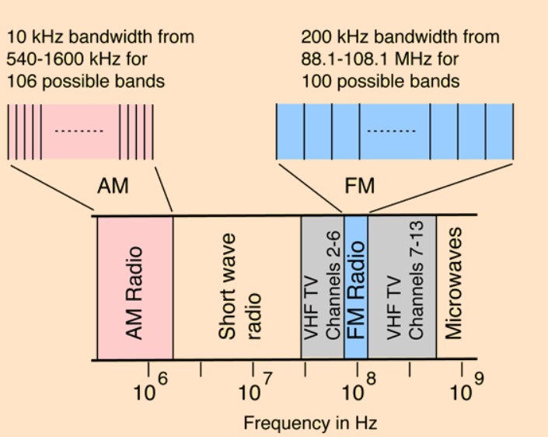
FM Bands

Slide 13
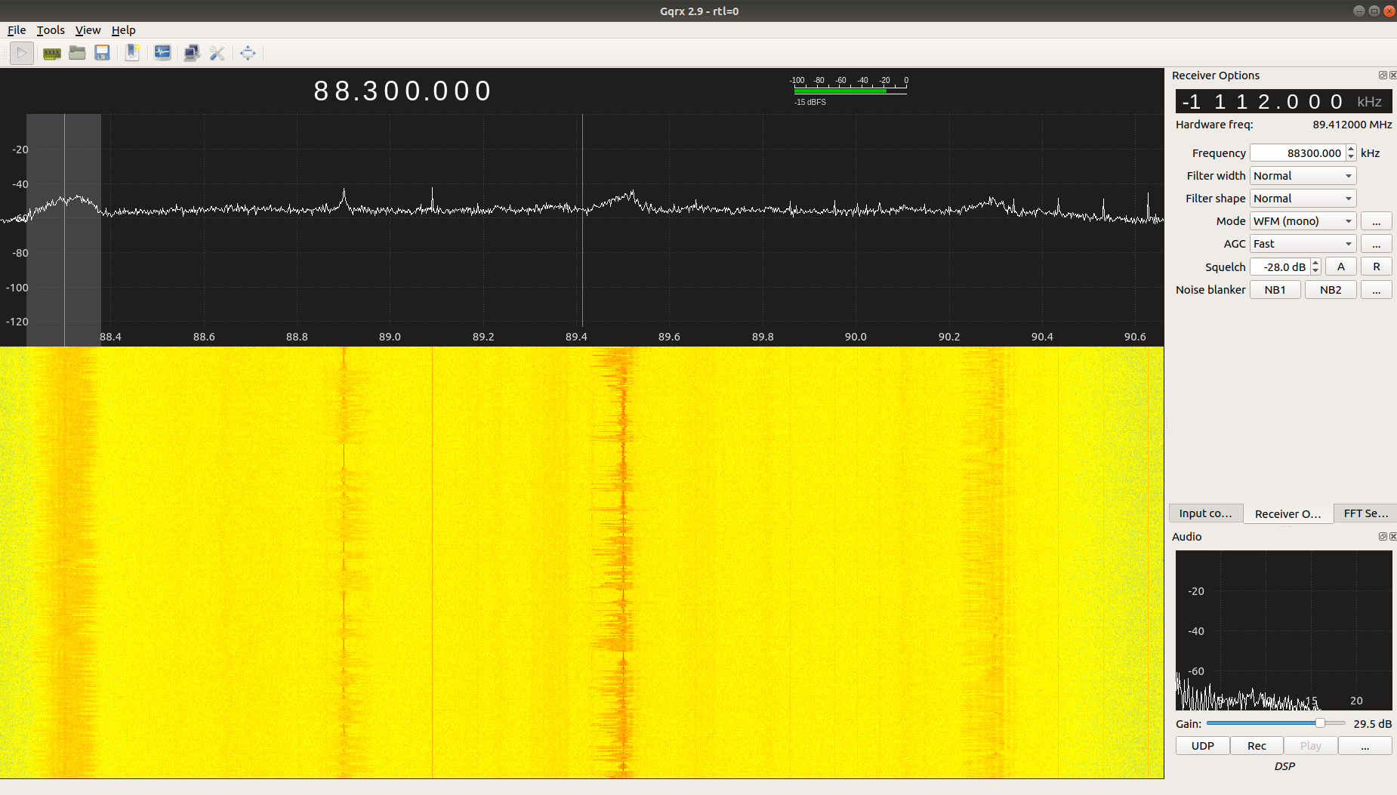
Radio Station Selection

Slide 14
Capture raw I/Q data using a RTL-SDR
Data recorded at:
Latitude 32.95145
Longitude -117.23778
Data can be recorded using the following command:
rtl_sdr -f (Frequency) -g (Gain) -s (Sample rate) -n (Number of Samples) (File Name).dat
Example: rtl_sdr -f 88300000 -g 28.4 -s 2500000 -n 25000000 FMcapture1.dat

Slide 15
Data Format
Raw I/Q data was captured from 88.3 FM radio station. The raw I/Q data format is a follows:
Real | 8 unsigned bit int
Imaginary | 8 unsigned bit int
Real | 8 unsigned bit int
Imaginary | 8 unsigned bit int
Real | ….
Imaginary | ….

Slide 16
Python Server
The PynqServer python script commands the RTL-SDR to capture raw I/Q packets, listens for a client who wants to connect, accepts a connection, and sends the data to the client.

Slide 17
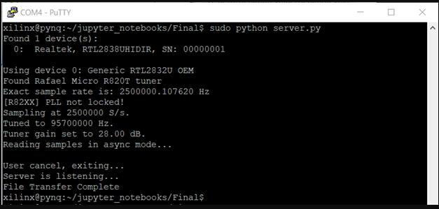
Python Server

Slide 18
Transport data to client
A python script is used to control the RTL-SDR and transport the raw I/Q data.
A TCP connection is used to transport the data.
The data will be transported over Ethernet for the purposes of our experiment.

Slide 19
PC Client
The PC client python script receives the data packet, writes the data to file and commands a custom built MatLab script to plot the data and process it for playback.

Slide 20
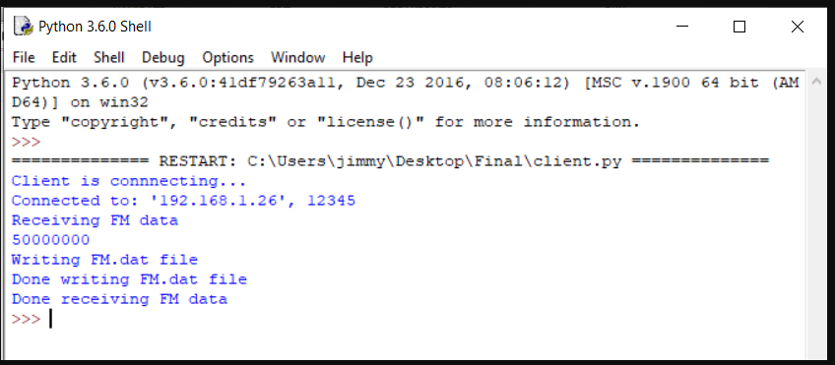
Python Client

Slide 21
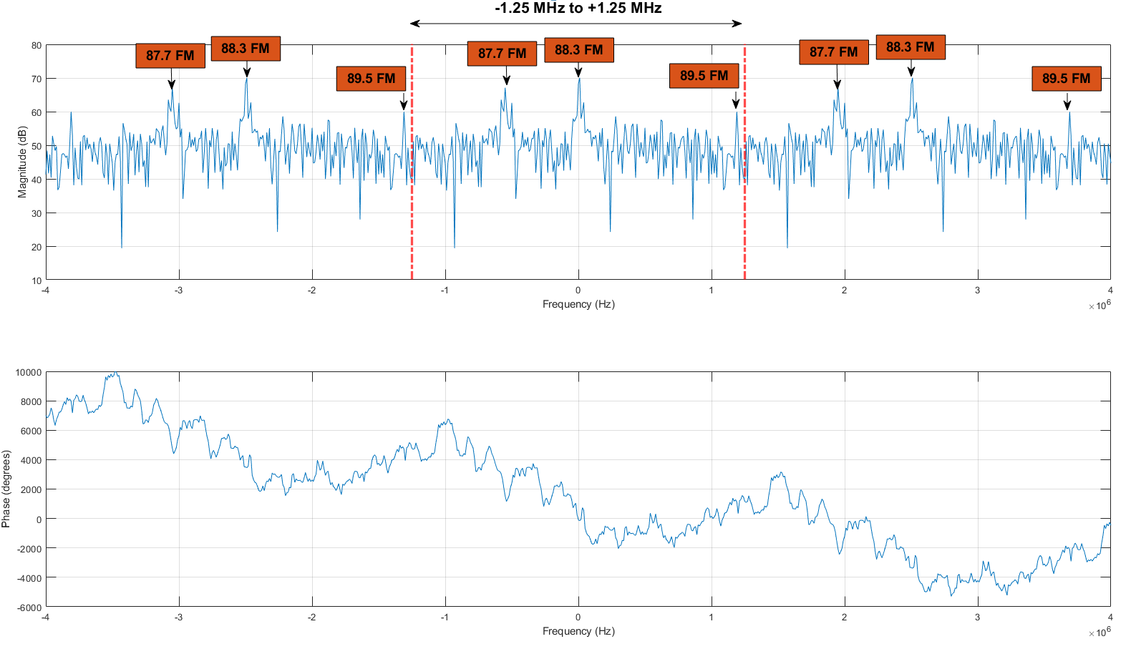
Freqz Plot

Slide 22
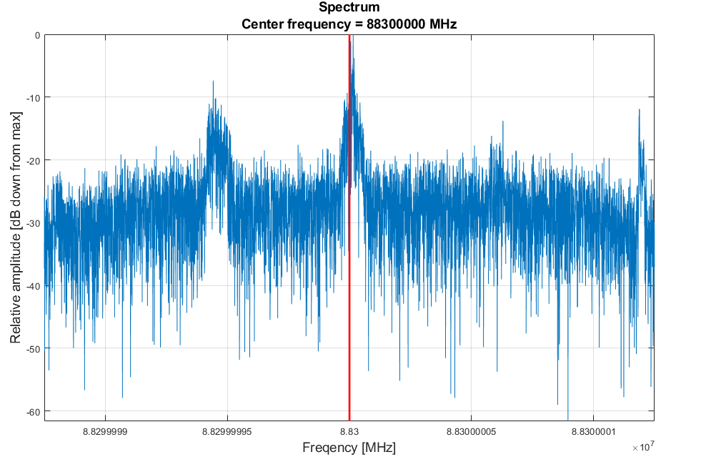
FFT plot

Slide 23
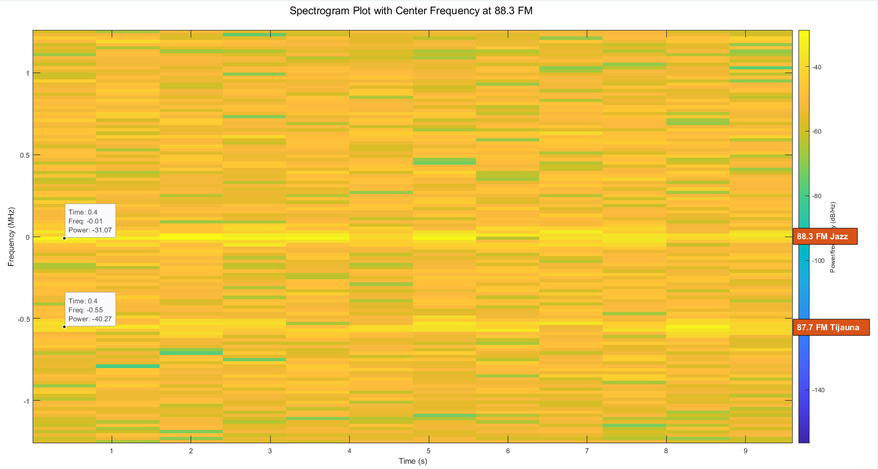
Spectrogram Plot

Slide 24
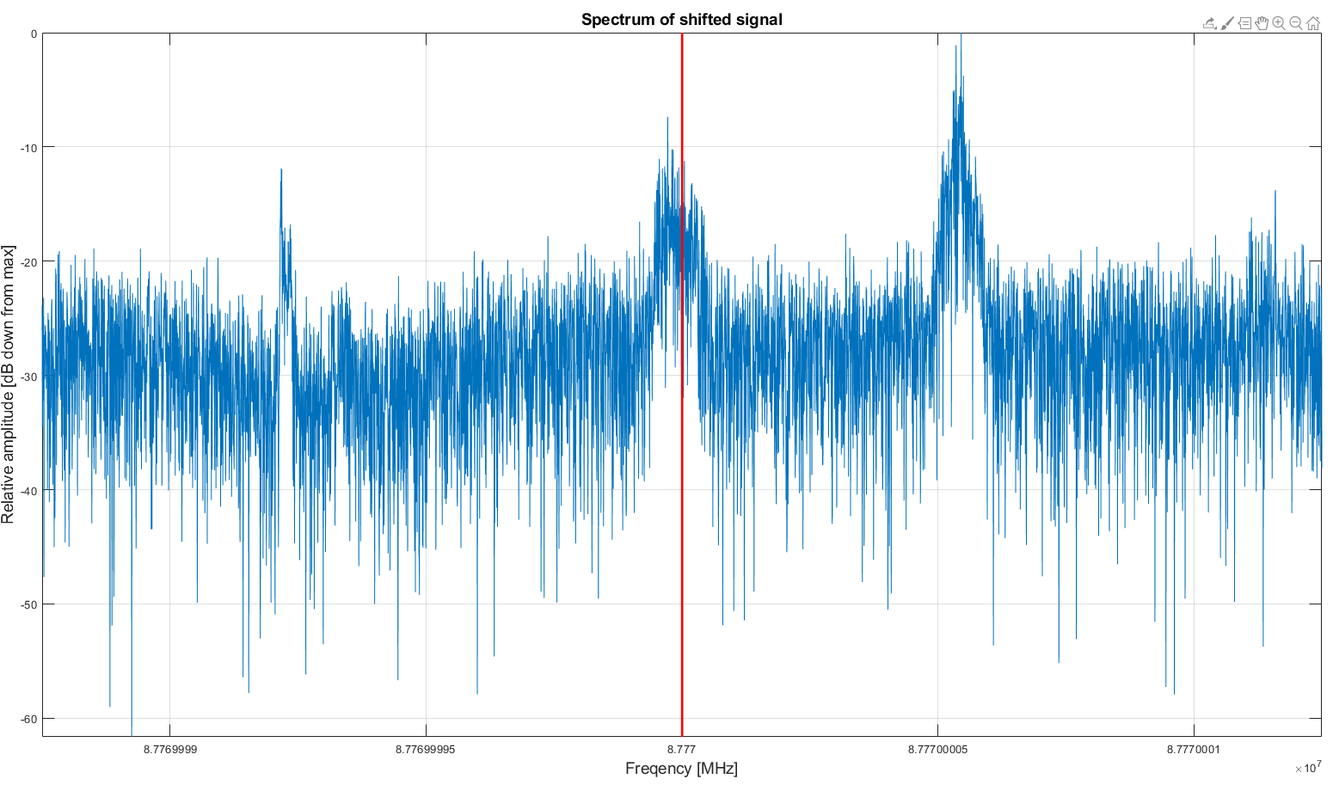
Shifted signal to 87.7 FM

Slide 25
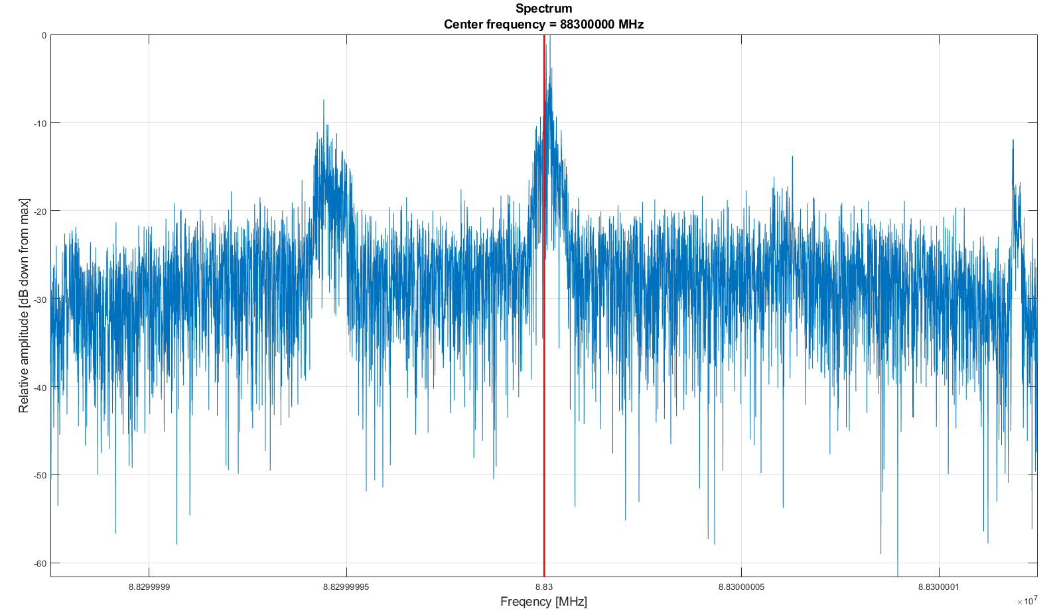
Signal centered at 88.3 FM

Slide 26
LPF Applied to Shifted Signal@ 88.3FM

Slide 27
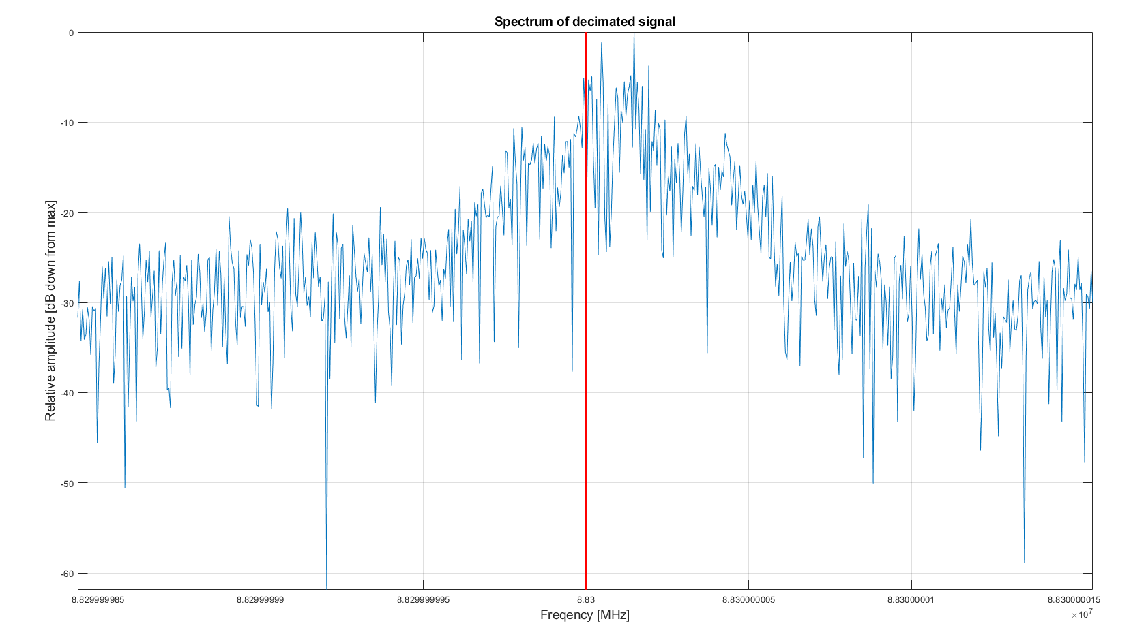
Decimated Signal Centered at 88.3 FM

Slide 28
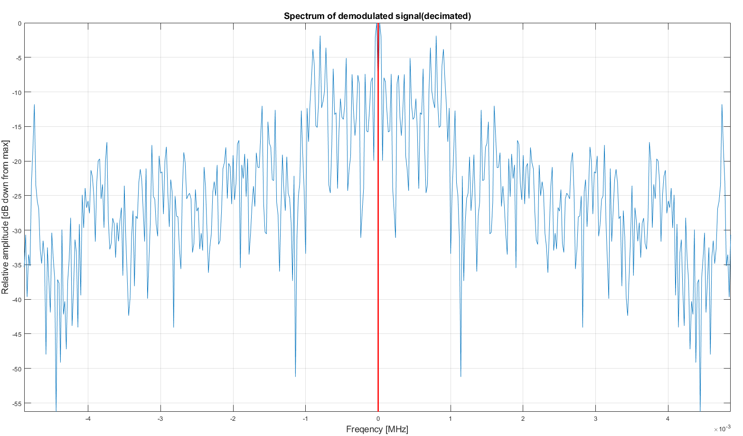
Demodulated 88.3 FM signal decimated

Slide 29
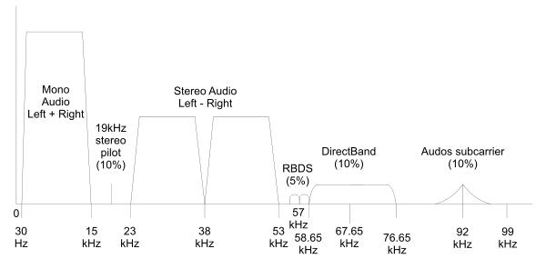
FM Broadcasting Spectrum

Slide 30
Challenges
Getting quality sound from captured data
Sampling rate needed to speed up the signal after decimation:
This significantly improves sound quality
Processing the signal
Memory constraints:
Wanted to capture 50 MB of data. Originally tried on the pynq board, but not enough RAM
Shifting
Frequency downshift:
Can be achieved by multiplying the signal by a complex exponential

Slide 31
Results
Failures:
Perform all signal processing on Pynq
Not enough RAM
Successfully:
Captured I/Q data packets
Transported data using TCP connection
Filtered data to create a high quality signal

Slide 32
Conclusions

Slide 33
Overall level of success
We successfully captured raw I/Q data from over the air, packetized it, transported it to a client pc, demodulated the data, and listened to the demodulated signal.

Slide 34
Potential fixes
Implement a more complex filter to improve sound quality across all radio stations within range.

Slide 35
Extensions or future work
Live stream radio
Perform all audio processing on Pynq Z2 and output sound.

Slide 36
Appendix
RTL_SDR
http://www.aaronscher.com/cgi-sys/suspendedpage.cgi
Dr. Aaron Scher aaron.scher@oit.edu Oregon Institute of Technology

Slide 37
Appendix
rtl_sdr, an I/Q recorder for RTL2832 based DVB-T receivers
Usage: [-f frequency_to_tune_to [Hz]
[-s samplerate (default: 2048000 Hz)]
[-d device_index (default: 0)]
[-g gain (default: 0 for auto)]
[-p ppm_error (default: 0)]
[-b output_block_size (default: 16 * 16384)]
[-n number of samples to read (default: 0, infinite)]
[-S force sync output (default: async)]
filename (a '-' dumps samples to stdout)

Slide 38
Appendix
http://hyperphysics.phy-astr.gsu.edu/hbase/Audio/radio.html

Slide 39
Video
https://youtu.be/mTuTQso04Wc

